Slide 1
Smith-Chart
Introduction
to the
Smith Chart
Prof. F. Dellsperger

Slide 2
Smith-Chart
From theory of lines:
Eq. 1
Normalized Z = z = r + jx
Eq. 2
Eq. 3

Slide 3
Smith-Chart
Representation of Reflection Coefficient in Polar Diagram:

Slide 4
Smith-Chart
According to Eq.1, each reflection coefficient must also represent a complex impedance Z, or according to Eq.3 a complex normalized impedance z.

Slide 5
Smith-Chart
Why not overlay a grid with impedance values?
This would help to visualize Eq. 1 and 3.
It would also help to visualize the effect of changing elements in a network.
For example:
For a given load impedance consisting of a serie R – L -network the value of L changes by a certain value.
How does it affect the reflection coefficient (or VSWR)?

Slide 6
Smith-Chart
Let‘s first consider a few special points.
Short circuit: R=0, X=0, (r=0, x=0)
Open circuit: R=∞, X=0, (r=∞, x=0)
Z = Z₀: R=50, X=0, (r=1, x=0)
Short
Z₀
Open

Slide 7
Smith-Chart
Draw the locus for r = 1 (R=Z₀) and -∞<x<+∞
r =
1
1
-10
-4
-2
-1
-0.5
-0.1
+0.5
+1
0
+0.1
+2
+4
+10
+∞
x =
-∞
This gives a constant-r-circle for r = 1

Slide 8
Smith-Chart
Draw the locus for r = 0.5 (R=0.5Z₀) and -∞<x<+∞
r =
0.5
0.5
1
-10
-4
-2
-1
-0.5
-0.1
+0.5
+1
0
+0.1
+2
+4
+10
+∞
x =
-∞
This gives a constant-r-circle for r = 0.5

Slide 9
Smith-Chart
Draw the locus for r = 0.2, 2, 4 and -∞<x<+∞
0.2
2
r =
4
0.2
0.5
1
2
4
-10
-4
-2
-1
-0.5
-0.1
+0.5
+1
0
+0.1
+2
+4
+10
+∞
-∞
-10
-4
-2
-1
-0.5
-0.1
+0.5
+1
0
+0.1
+2
+4
+10
+∞
-10
-4
-2
-1
-0.5
-0.1
+0.5
+1
-∞
0
+0.1
+2
+4
+10
+∞
x =
-∞
More
constant-r-circles

Slide 10
Smith-Chart
Locus for r = 0.2, 0.5, 1, 2, 4 and -∞<x<+∞
r =
0.2, 0.5, 1, 2, 4
-∞<x<+∞
0.2
0.5
1
2
4
Locus for constant
real part of impedance

Slide 11
Smith-Chart
Draw the locus for x = 1 (X=Z₀) and 0<r<+∞
1
1
0.2
x =
2
0.2
0.5
1
2
4
10
4
+∞
1
0.2
0
2
r =
0.5
This gives a constant-x-circle for x = 1

Slide 12
Smith-Chart
Draw the locus for x = -1 (X = -Z₀) and 0<r<+∞
1
-1
0.2
x =
2
0.2
0.5
1
2
4
10
4
+∞
1
0.2
0
2
r =
0.5
This gives a constant-x-circle for x = -1
-1

Slide 13
Smith-Chart
Draw the locus for x = ±0.2, ±0.5, ±2, ±4, ±10 and 0<r<+∞
1
0.5
2
0.2
4
-4
-10
-2
+0.2
-0.5
+2
+0.5
+10
-0.2
x =
+4
0.2
0.5
1
2
4
r =
0<r<+∞
-0.2
-4
Locus for constant
imaginary part of impedance
-0.5
-2
-1

Slide 14
Smith-Chart
Impedance plane

Slide 15
Smith-Chart
Impedance plane
Serie L or C
Real part of impedance = constant

Slide 16
Smith-Chart
Impedance plane
Serie R
Imaginary part of impedance = constant

Slide 17
Smith-Chart
Impedance plane
Circles of
constant |Γ| and VSWR
VSWR = 2
|Γ| = 0.6

Slide 18
Smith-Chart
Impedance plane
Serie transmission line
with Z = Z₀
VSWR = 4
The center of constant VSWR-circle is the center of Smith-Chart if Smith-Chart is normalized to the line impedance.

Slide 19
Smith-Chart
Admittance chart:
Eq. 4
Normalized Y= y
Eq. 5
Eq. 6

Slide 20
Smith-Chart
According to Eq.4, each reflection coefficient must also represent a complex admittance Y, or according to Eq.6 a complex normalized admittance y.

Slide 21
Smith-Chart
Using the similar procedure as with the impedance plane we get circles for constant conductance g and arcs for constant susceptance b.
Admittance plane
Locus for constant
imaginary part of
admittance
Locus for constant
real part of admittance

Slide 22
Smith-Chart
Admittance plane
Parallel L or C
Real part of admittance = constant

Slide 23
Smith-Chart
Imittance chart
Overlay of impedance and admittance plane

Slide 24
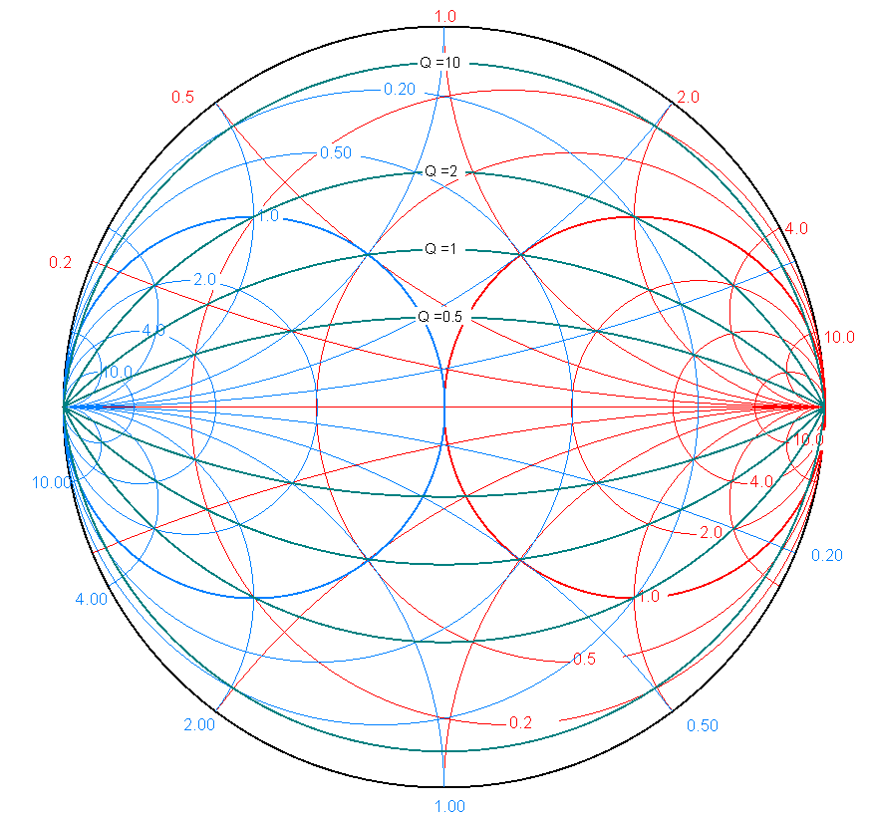
Smith-Chart
Constant-Q circles

Slide 25
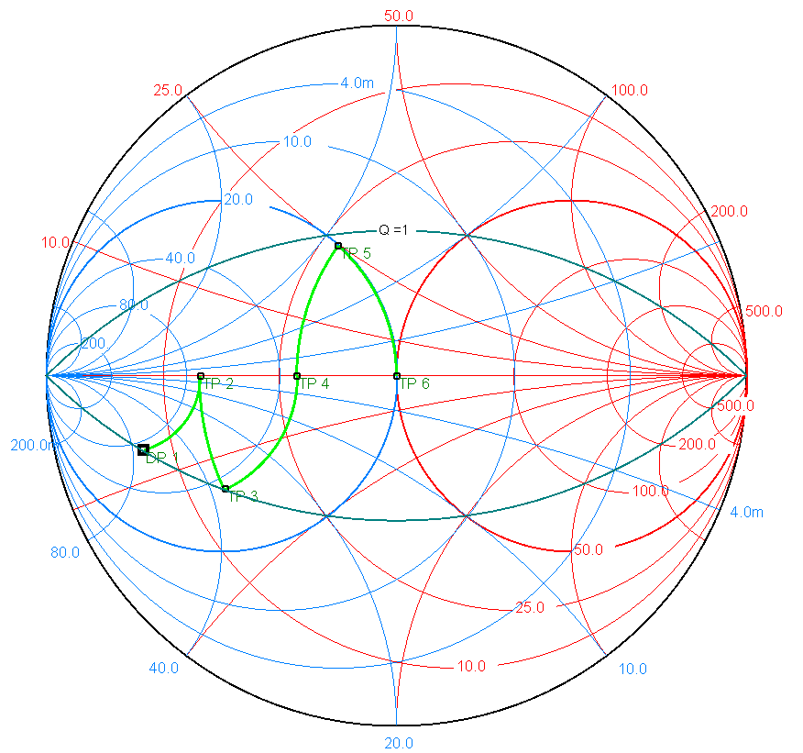
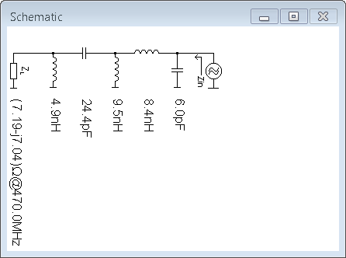
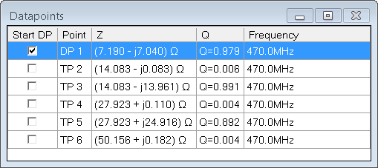
Smith-Chart
Example using „Smith“-Software
www.fritz.dellsperger.net

Slide 26
Smith-Chart
L-networks for maching Z₂ to Z₀

Slide 27
Smith-Chart
L-networks for maching Z₂ to Z₀

Slide 28
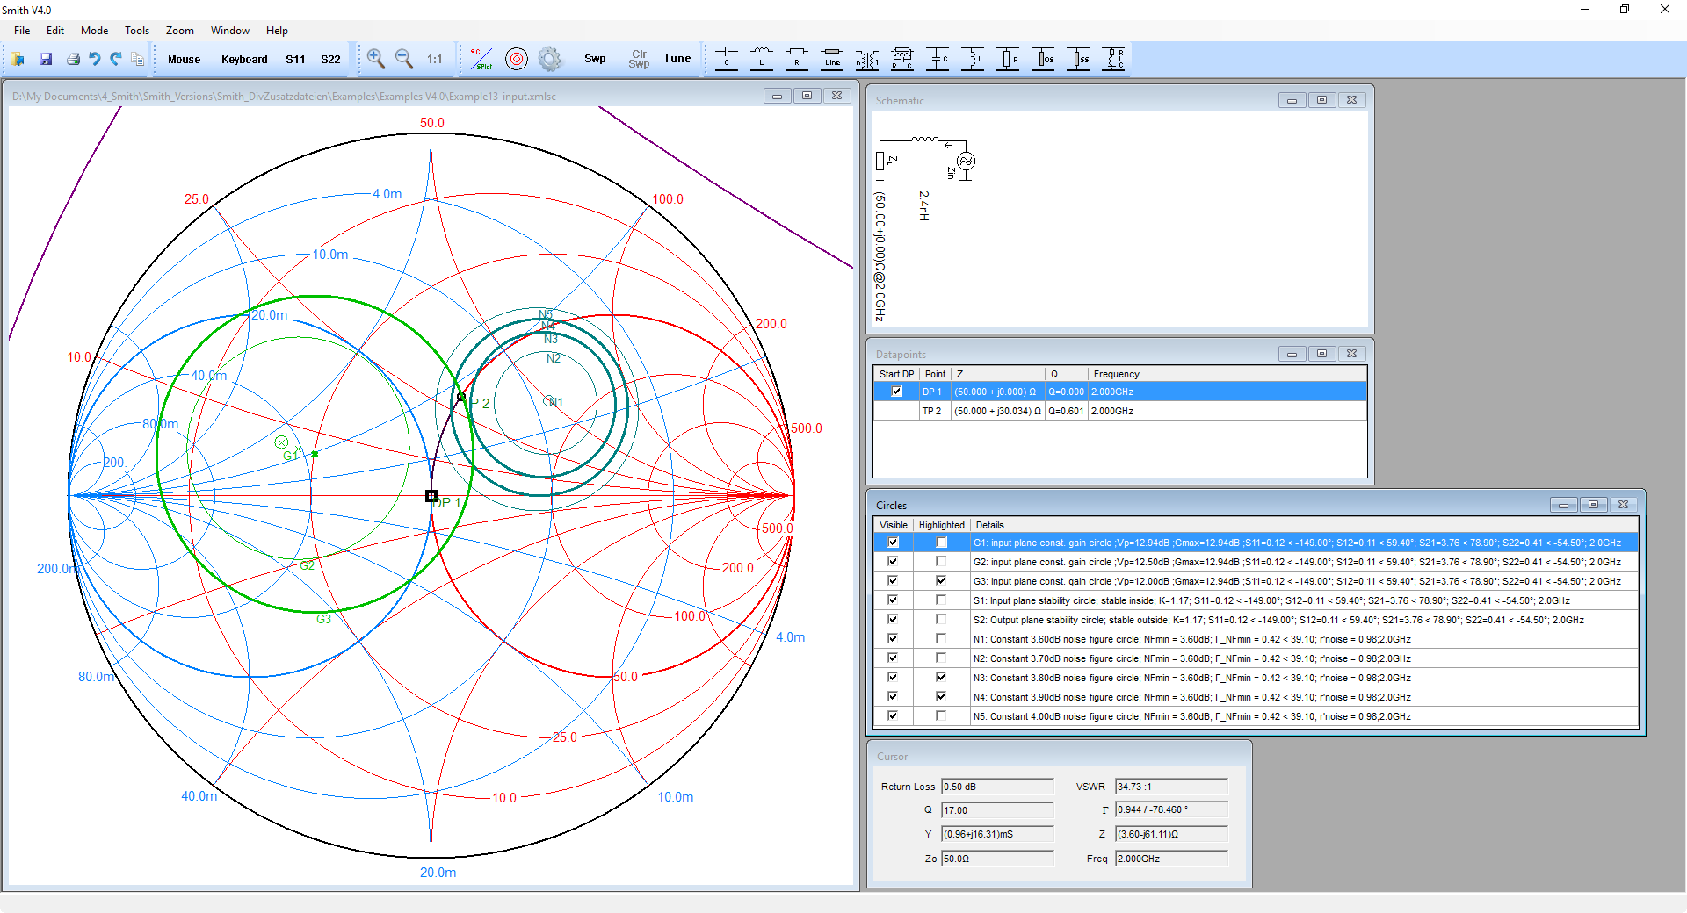
Smith-Chart
Software: Smith V4.0 www.fritz.dellsperger.net

